Slide 1
OOP
Muhammad Naeem Akhtar
Week-04

Slide 2
Contents
04 | Setters and getters of pointer attributes Deep Copy vs Shallow Copy Copy Constructors Constant data members Constant member functions Constructor Initializer Lists this pointer | Text Book Chapter: 09 Reference Book Chapter: 12 Page: 807 & 812 Text Book Chapter: 10 Section: 10.2 & 10.5 | Assignment:01 | CLO2, CLO3

Slide 3
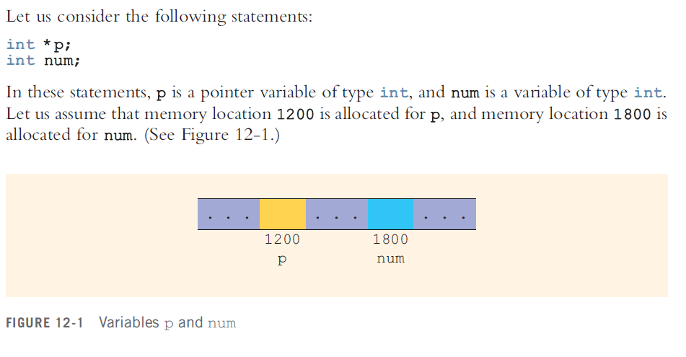
Pointers

Slide 4
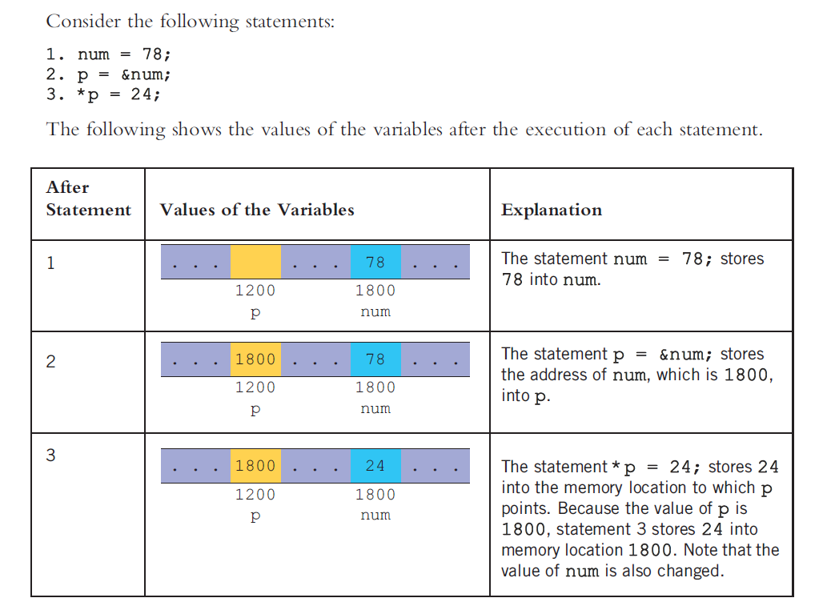
Pointers

Slide 5
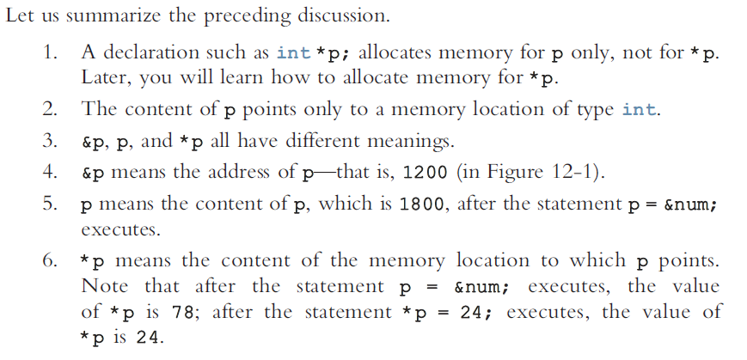
Pointers

Slide 6
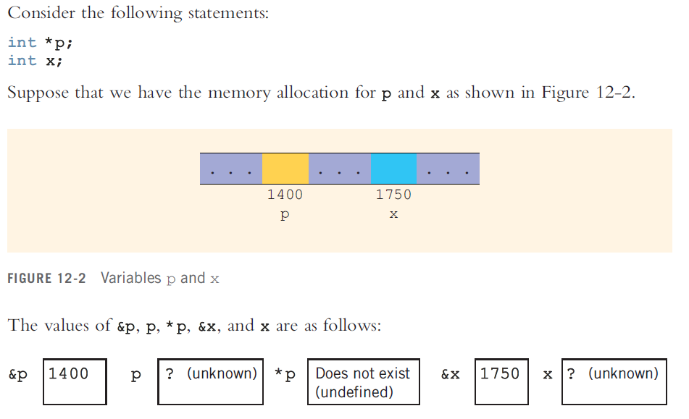
Pointers

Slide 7
Pointers
See: PointersPractice.cpp

Slide 8
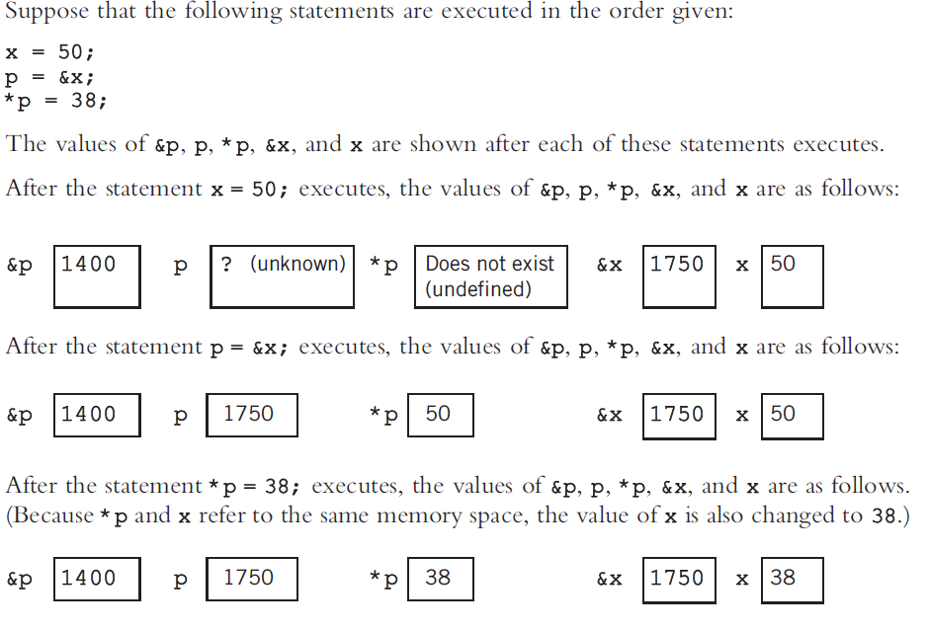
Pointers

Slide 9
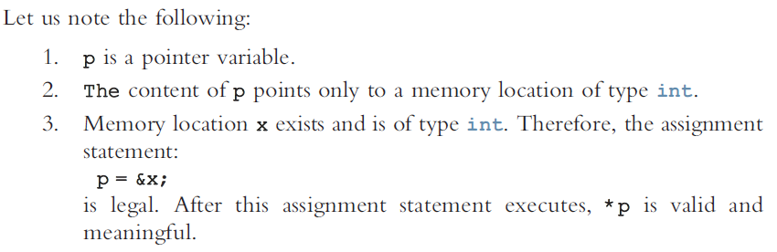
Pointers

Slide 10
Initializing Pointer Variables
p = NULL; // This is better than
p = 0;
Both are same

Slide 11
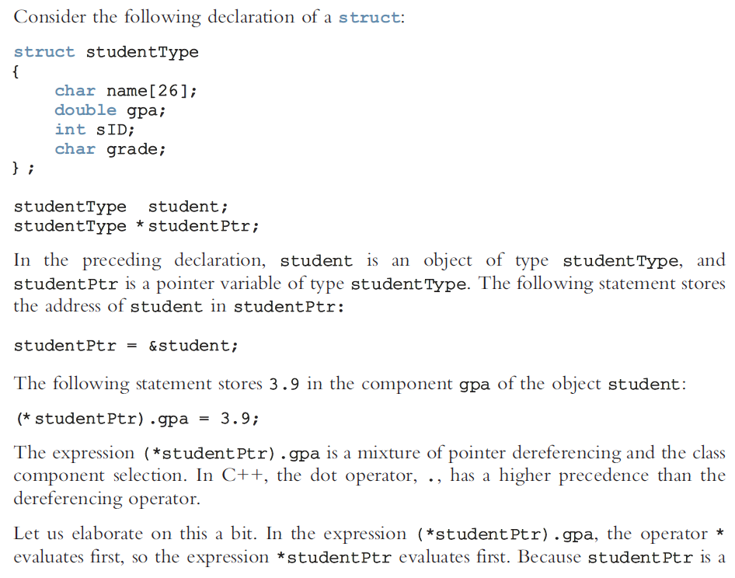


Classes and Pointers

Slide 12
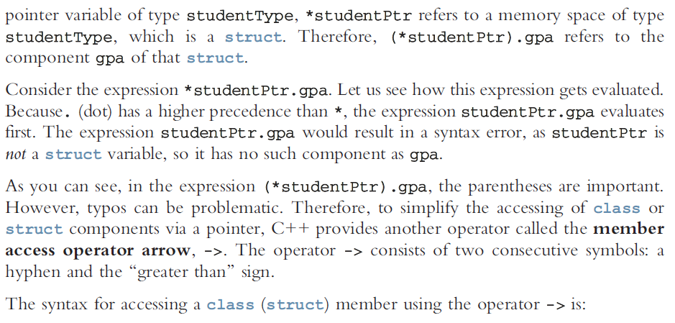


Classes and Pointers

Slide 13
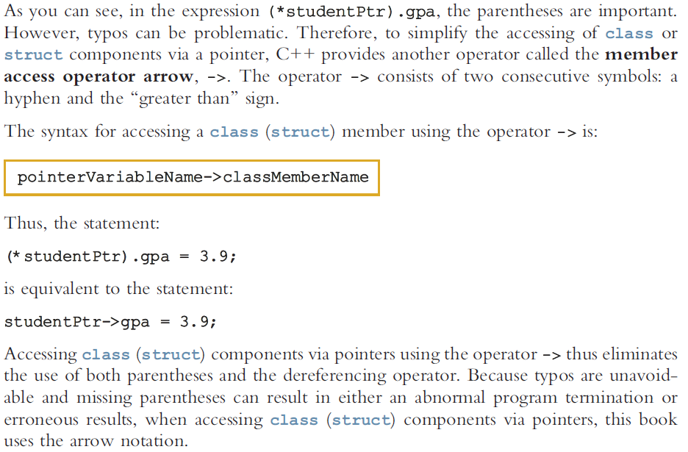
Classes and Pointers

Slide 14
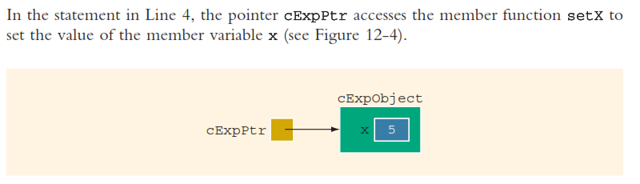
Classes and Pointers
See example PointerandClasses01.cpp
&
AccesingMemberFunctionUsingdotandref

Slide 15
Dynamic Variables
Why Pointers when we have variables. (CP-01)
Variables that are created during program execution are called dynamic variables.
To create dynamic variables
new
To destroy dynamic variable
delete

Slide 16
Operator new
new dataType; //to allocate a single variable
new dataType[intExp]; //to allocate an array of variables

Slide 17
Shallow versus Deep Copy and Pointers
//Consider the following code snippet
int *first;
int *second;
first = new int[10];
second=first

Slide 18
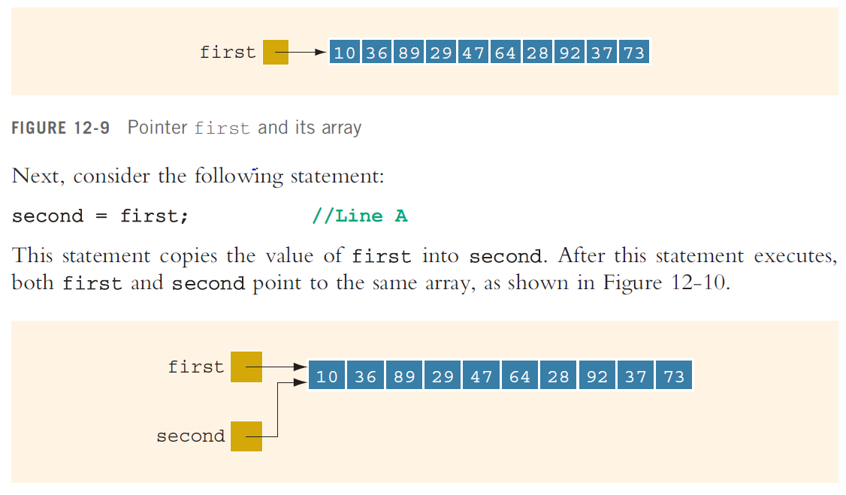
Shallow vs Deep Copy
Shallow Copy

Slide 19
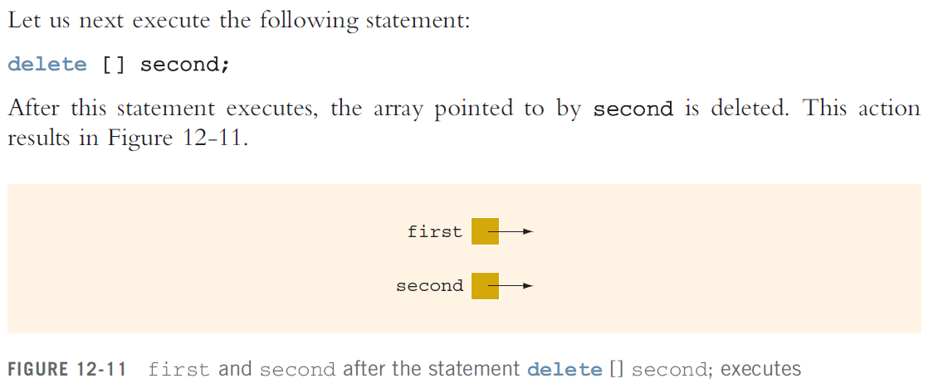
Shallow vs Deep Copy
first and second are Dangling Pointers

Slide 20
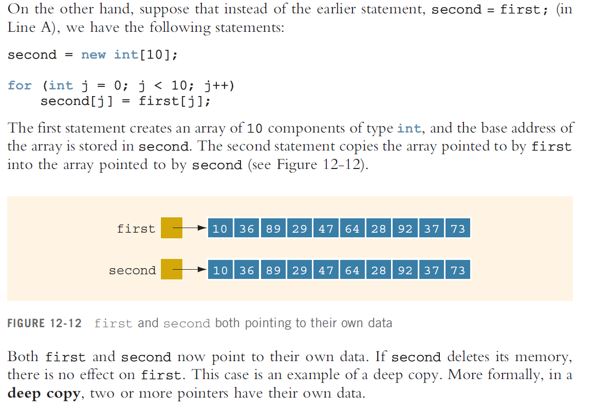
Shallow vs Deep Copy
Deep Copy

Slide 21
Constant Data Member
Initialized variable. Read-only
See ConstantDataMember1,2.cpp

Slide 22
Const member functions in C++
Constant member functions are those functions that are denied permission to change the values of the data members of their class.
int get_data() const;
int class1::get_data() const {//body of function}
or
int get_data() const {//body of function}

Slide 23
Point to Ponder
When a function is declared as const, it can be called on any type of object.
Non-const functions can only be called by non-const objects.
Constant object can only call const member function
See: ConstantMemberFunction1.cpp-ConstantMemberFunction4.cpp

Slide 24
Constructors
A constructor is different from normal functions in following ways:
Constructor has same name as the class itself
Default Constructors don’t have input argument however, Copy and Parameterized Constructors have input arguments
Constructors don’t have return type
A constructor is automatically called when an object is created.
It must be placed in public section of class.
If we do not specify a constructor, C++ compiler generates a default constructor for object (expects no parameters and has an empty body).
See constructor1,2,3.cpp

Slide 25
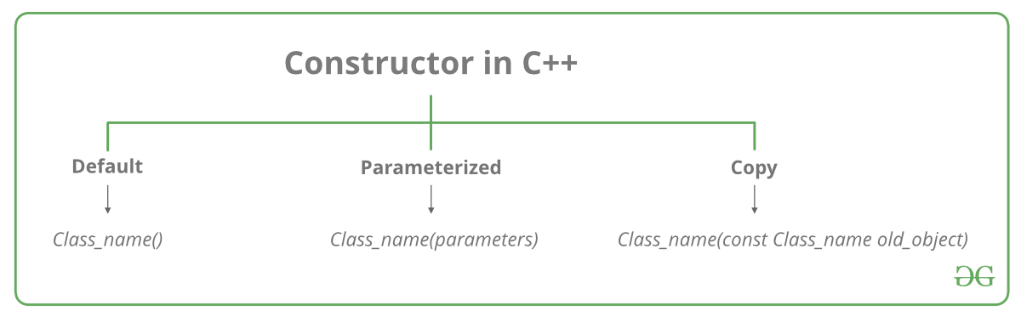
Constructors

Slide 26
Let us understand the types of constructors in C++ by taking a real-world example. Suppose you went to a shop to buy a marker. When you want to buy a marker, what are the options. The first one you go to a shop and say give me a marker. So just saying give me a marker mean that you did not set which brand name and which color, you didn’t mention anything just say you want a marker. So when we said just I want a marker so whatever the frequently sold marker is there in the market or in his shop he will simply hand over that. And this is what a default constructor is! The second method is you go to a shop and say I want a marker a red in color and XYZ brand. So you are mentioning this and he will give you that marker. So in this case you have given the parameters. And this is what a parameterized constructor is! Then the third one you go to a shop and say I want a marker like this(a physical marker on your hand). So the shopkeeper will see that marker. Okay, and he will give a new marker for you. So copy of that marker. And that’s what a copy constructor is!

Slide 27
Characteristics of the constructor
The name of the constructor is the same as its class name.
Constructors are mostly declared in the public section of the class though it can be declared in the private section of the class.
Constructors do not return values; hence they do not have a return type.
A constructor gets called automatically when we create the object of the class.
Constructors can be overloaded.
Constructor can not be declared virtual.

Slide 28
Point to Ponder
when the parameterized constructor is defined and no default constructor is defined explicitly, the compiler will not implicitly call the default constructor and hence creating a simple object as
Student s; //Will flash an error
See constructor4,5.cpp

Slide 29
Explicit and Implicit Call
Example e = Example(0, 50); // Explicit call
Example e(0, 50); // Implicit call

Slide 30
Uses of Parameterized constructor:
It is used to initialize the various data elements of different objects with different values when they are created.
It is used to overload constructors.
See constructor6.cpp

Slide 31
Copy Constructor
Implicit Copy Constructor
Automatically created by compiler.
See copyconstructor1.cpp
Explicit Copy Constructor
User defined.
See copyconstructor2.cpp

Slide 32
Characteristics of Copy Constructor
The copy constructor is used to initialize the members of a newly created object by copying the members of an already existing object.
Copy constructor takes a reference to an object of the same class as an argument.
myClass (myClass &obj1)
{
id=obj1.id;
}
The process of initializing members of an object through a copy constructor is known as copy initialization.

Slide 33
Characteristics of Copy Constructor
It is also called member-wise initialization because the copy constructor initializes one object with the existing object, both belonging to the same class on a member-by-member copy basis.
The copy constructor can be defined explicitly by the programmer. If the programmer does not define the copy constructor, the compiler does it for us.

